Slide 1

Determining Pokémon stats with MARS
Frank Devone

Slide 2

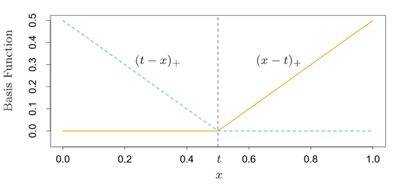

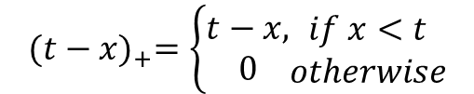
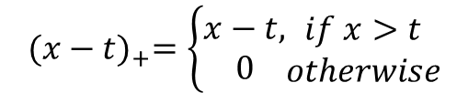
What is MARS?
Stands for Multivariate Adaptive Regression Splines
Performs a stepwise process that builds knots out of piecewise functions as we’d seen previously in our in-class linear spline studies
‘t’ is the location of our knot
Basis Functions:
$${(x−t)}_{+}=\left\{\begin{matrix}x−t, \\ 0\end{matrix}\begin{matrix}if x>t \\ otherwise\end{matrix}\right.$$
$${(t−x)}_{+}=\left\{\begin{matrix}t−x, \\ 0\end{matrix}\begin{matrix}if x<t \\ otherwise\end{matrix}\right.$$
*Notes and graphs via: “The Elements of Statistical Learning:” Hastie, Tibshirani, and Friedman

Slide 3



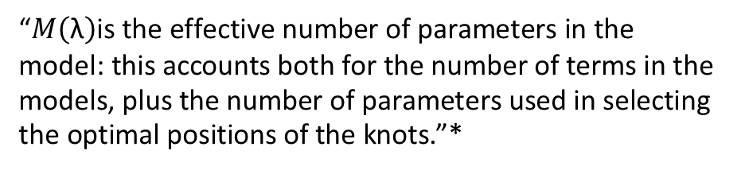
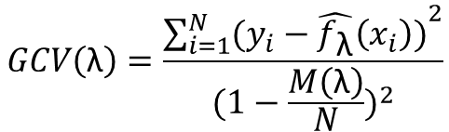
Forward Pass
Backward Pass
Similar to our traditional Forwards stepwise regression only in addition to new and existing terms also considers all possible basis functions or a product of two!
Start only with the intercept.
We minimize the residual sum-of-squares
This pass alone creates a large model that is prone to over fitting
After the forward pass is done begins deleting terms based on smallest increases in residual squared error.
Where λ is the number of predictors in the model we create a best fitting model for each possible λ
We select the value of λ via a generalized cross-validation criterion:
$$GCV\left(\text{λ}\right)=\frac{{\sum_{i=1}^{N}{(y_{i}−\hat{f_{\text{λ}}}\left(x_{i}\right))}}^{2}}{{(1−\frac{M\left(\text{λ}\right)}{N})}^{2}}$$
“$M\left(\text{λ}\right)\text{is} \text{the} \text{effective} \text{number} \text{of} \text{parameters} \text{in} \text{the} \text{model}\text{: }\text{this} \text{accounts} \text{both} \text{for} \text{the} \text{number} \text{of} \text{terms} \text{in} \text{the} \text{models}\text{, }\text{plus} \text{the} \text{number} \text{of} \text{parameters} \text{used} \text{in} \text{selecting} \text{the} \text{optimal} \text{positions} \text{of} \text{the} \text{knots}\text{.}$”*
* “The Elements of Statistical Learning:” Hastie, Tibshirani, and Friedman

Slide 4
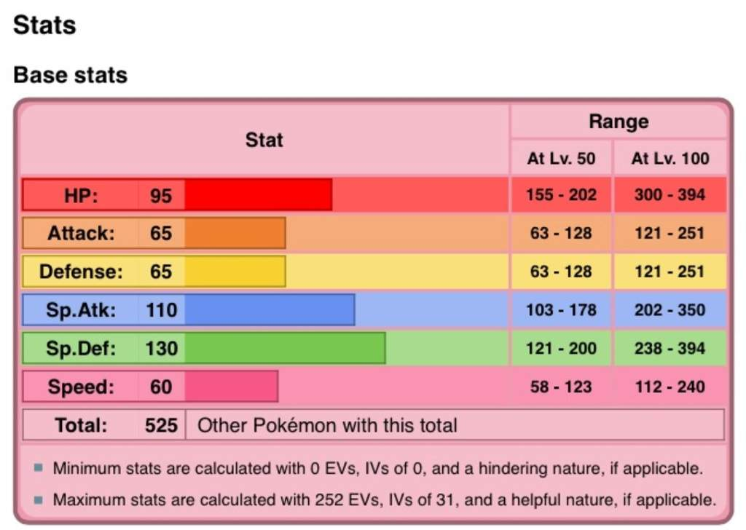

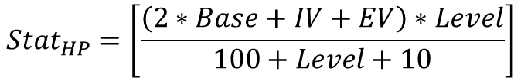
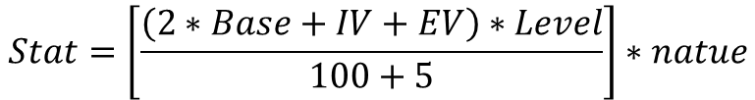
What are Pokémon Statistics?
Pokémon have 6 total statistics that make up their effectiveness
These vary in game over time based upon things know as IV and EV levels, and vary per Pokémon nature
For the purposes of this analysis we choose to only focus on “Base” which differ across Pokémon species but not individual Pokémon
Can we successfully predict base stats on the physical characteristics of Pokémon alone?
Our initial analysis looks at Total
$$Stat=\left[\frac{\left(2∗Base+IV+EV\right)∗Level}{100+5}\right]∗natue$$
$${Stat}_{HP}=\left[\frac{\left(2∗Base+IV+EV\right)∗Level}{100+Level+10}\right]$$
Sylveon

Slide 5
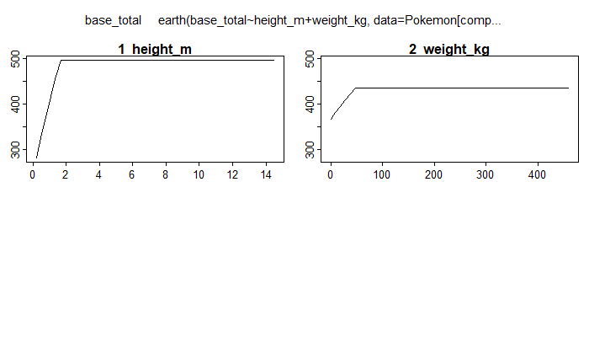

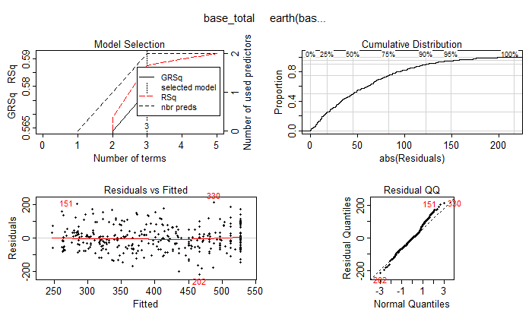

MARS Example Using Pokémon Height & Weight and Prediction Base Total
Call: earth(formula=base_total~height_m+weight_kg, data=Pokemon[complete.cases(Pokemon),-1], nfold=10, ncross=30, varmod.method="lm")
coefficients
(Intercept) 527.53891
h(1.6-height_m) -153.00466
h(46.5-weight_kg) -1.46334
Selected 3 of 5 terms, and 2 of 2 predictors
Termination condition: RSq changed by less than 0.001 at 5 terms
Importance: height_m, weight_kg
Number of terms at each degree of interaction: 1 2 (additive model)
GCV 5584.368 RSS 1910250 GRSq 0.5780979 RSq 0.5876591

Slide 6



The Problem with Just Height and Weight
Haxorus
Gallade
Shuckle
1.8m
Weight: 106 kg
Weight: 52 kg
Weight: 21 kg
Defense: 90
Defense: 95
Defense: 230

Slide 7


Wailord
14.5 m
Weight: 398
Defense: 45
Weight: 106
Weight: 52
Weight: 21
Defense: 90
Defense: 95
Defense: 230

Slide 8

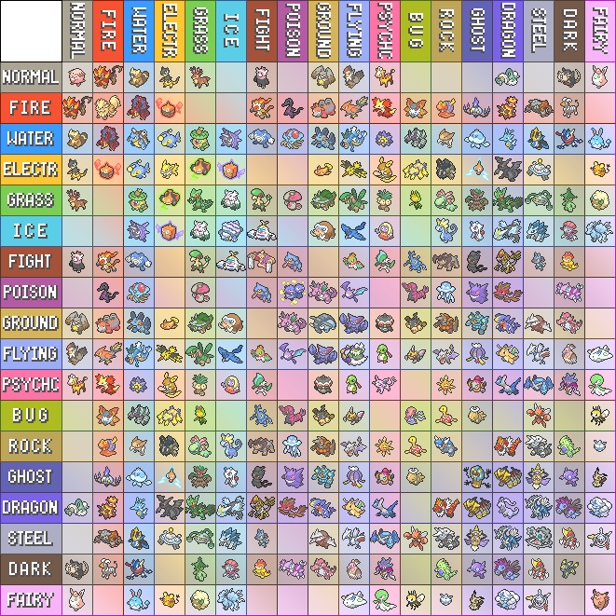
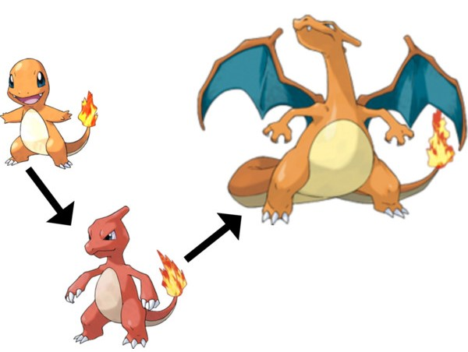
Additional Variables
Continuous Variables
Height
Weight
Experience Growth
Base Egg Steps
Capture Rate
Base Happiness
Stage of Evolution
Categorical Variables
Type one
Type two
Generation
Legendary Status
Interactions
Type one*Type two
Height*Weight
Base egg steps *
capture rate
Legendary Status *
Experience growth

Slide 9
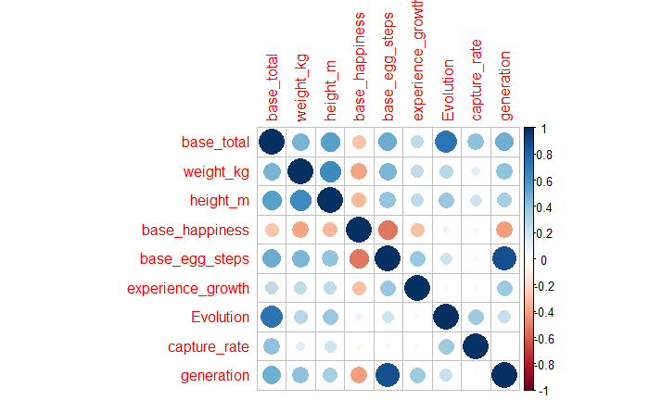

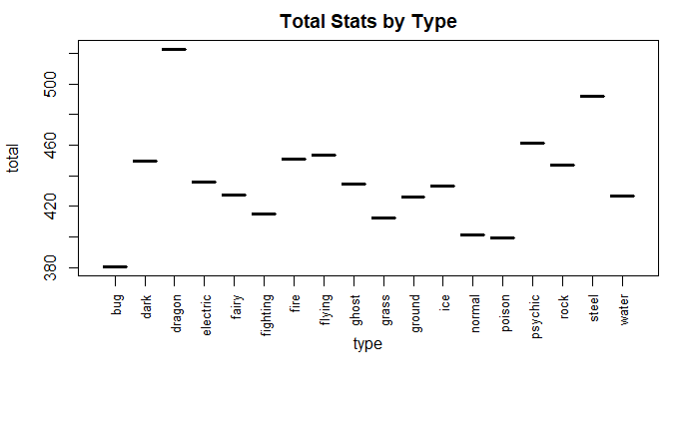
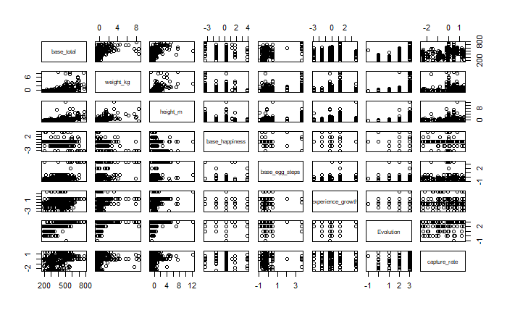
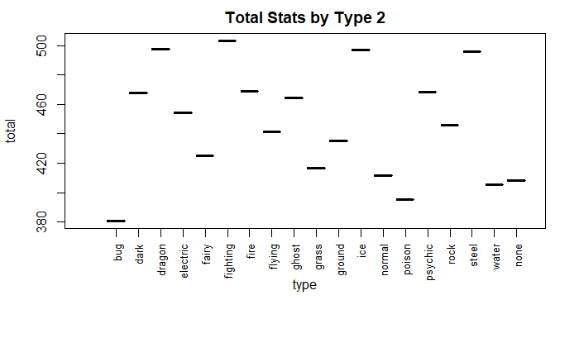
Additional Variables
*Some Pokémon like Agislash have unique typing (ghost/steel) so we look at type one and two as separate variables

Slide 10
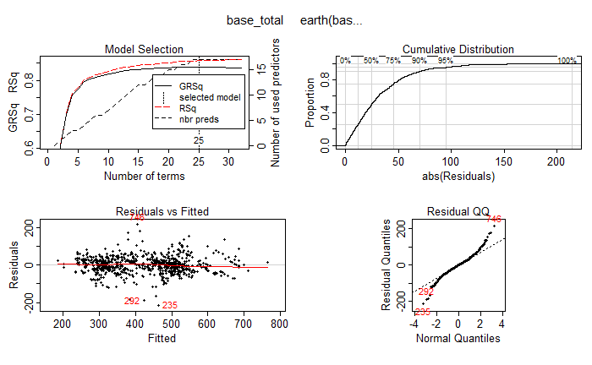
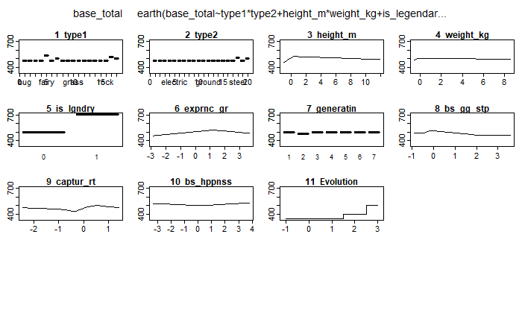


Results looking at Base Stat Model
R^2 for the final model is .8649
SD across all folds is 2.57
Positive coefficient type 1’s from left to right are fairy, fire, steel, and ghost
Positive coefficient type 2’s from left to right are steel and none
Based on 50 ten-fold cross validations
Outliers
Some Pokémon like Metagross have unusually high stats despite not being legendary, while others like Luvdisc are fully evolved/ have no evolution and have oddly low overall stats
Notes:
Other interactions exist but are rare and don’t show up on the spline graph. R^2 across all CV is low because some CV R^2 are <0

Slide 11

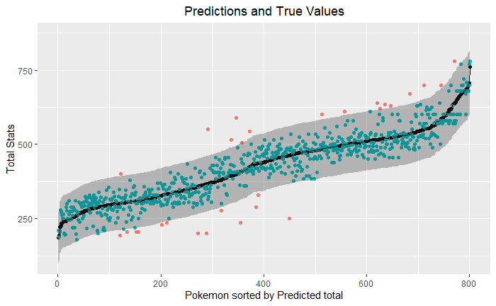

Slide 12






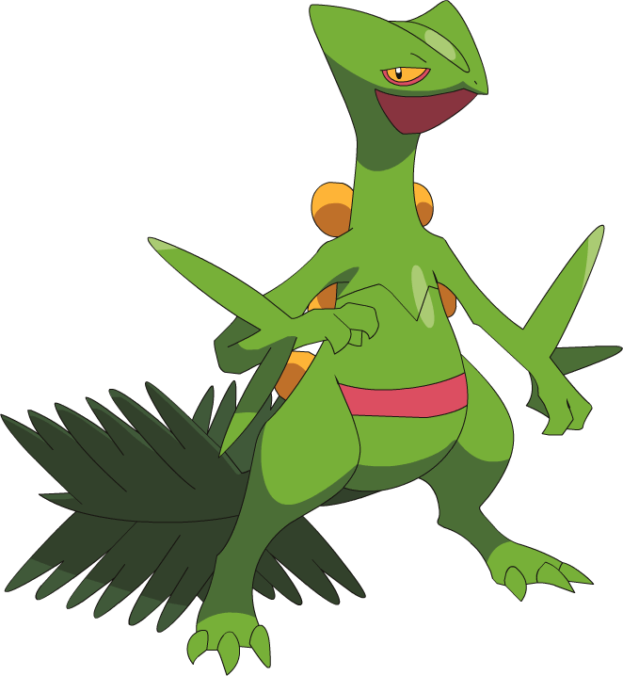

























Slide 13
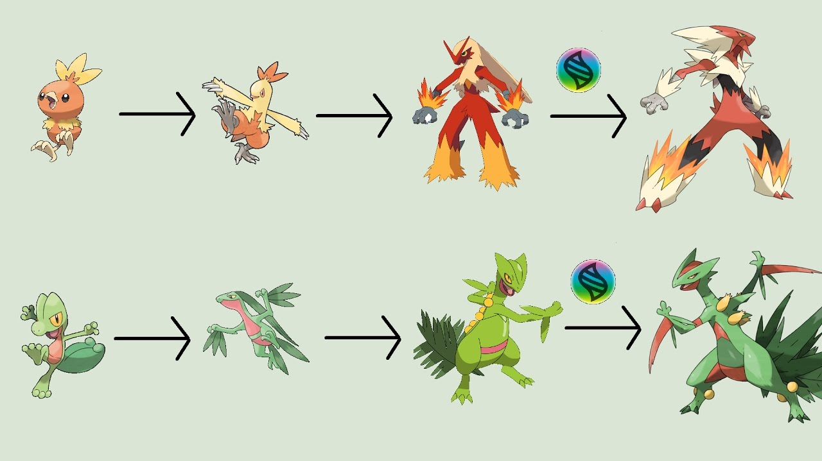

A Mega Problem
In Generation 6 a concept called “Mega-evolution” was introduced. It allows for a in battle form and stat increase. I realized that the web-scraping for the dataset (Kaggle sourced) is grabbing these stats instead of the true base stats. These would have to be manually changed. 46 out of 801 (5.8%) of Pokémon can mega-evolve.

Slide 14


Proposed Process for Determining the Other Statistics
1) Build 6 models for each statistic
2) Pick the model with the highest $r^{2}$value
2) Pick the model with the highest 𝑟^2value
3) Put the predictions from that model into the dataset as true
6) Put the predictions from that model into the dataset as true
5) Pick the model with the highest $r^{2}$value
5) Pick the model with the highest 𝑟^2value
4) Build 6-k models for each statistic where k is the number of accepted models
7) Repeat steps 4-6 until k=5
8) Build a model on the last statistic and total, pick the model with the highest $r^{2}$value
8) Build a model on the last statistic and total, pick the model with the highest 𝑟^2value
9) Use simple subtraction or addition to determine either the total or the final statistic

Slide 15

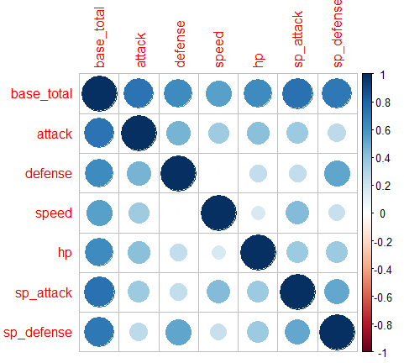
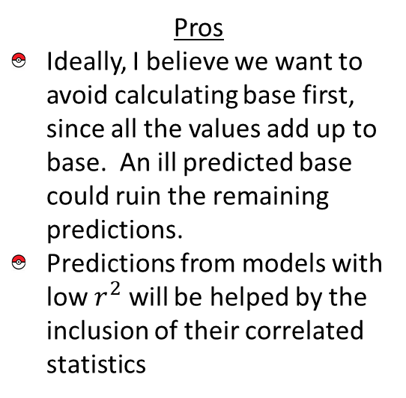
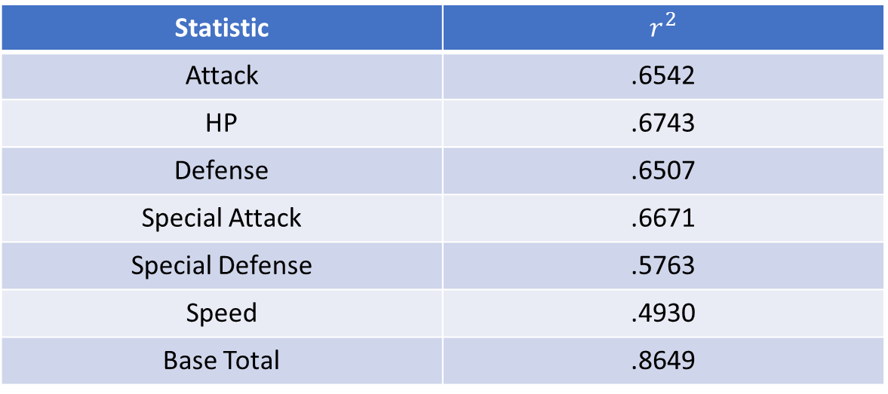
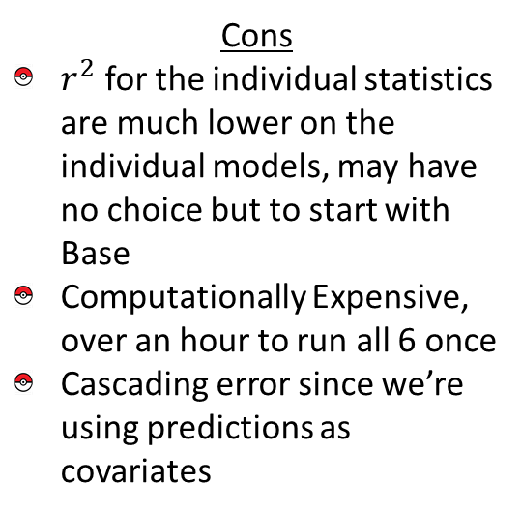
Issues with the Proposed Process
Pros
Ideally, I believe we want to avoid calculating base first, since all the values add up to base. An ill predicted base could ruin the remaining predictions.
Predictions from models with low $r^{2}$ will be helped by the inclusion of their correlated statistics
Cons
$r^{2}$ for the individual statistics are much lower on the individual models, may have no choice but to start with Base
Computationally Expensive, over an hour to run all 6 once
Cascading error since we’re using predictions as covariates
Statistic | $$r^{2}$$
Attack | .6542
HP | .6743
Defense | .6507
Special Attack | .6671
Special Defense | .5763
Speed | .4930
Base Total | .8649

Slide 16
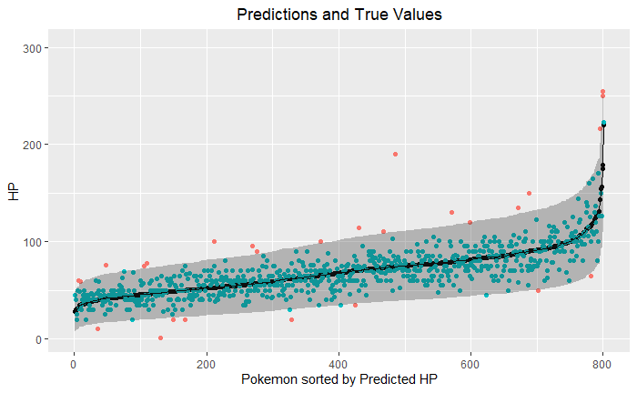

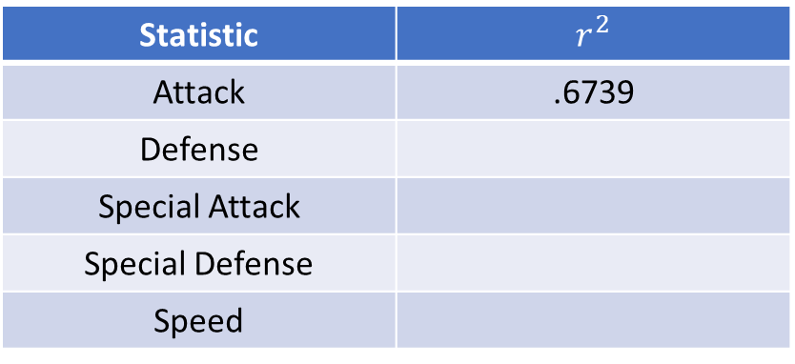
Up to Step 4 in our Proposed Process
Next Batch of Models
Statistic | $$r^{2}$$
Attack | .6739
Defense
Special Attack
Special Defense
Speed

Slide 17


Conclusions
Can create a well functioning model using MARS that predicts the base stats of a Pokémon
Predicting their individual stats may prove more of a challenge and will need to be done one at a time. Fixing the mega-evolution issue may increase predictive ability.
Ideally, despite the multiple cross-validations, we’d have a pure test set. I have yet to find data on the most recent generation that was not included in this dataset. Pending that we could remove an existing gen to act as a pure test set, however our sample size is already a bit low for the analysis we are performing

